Slide 2
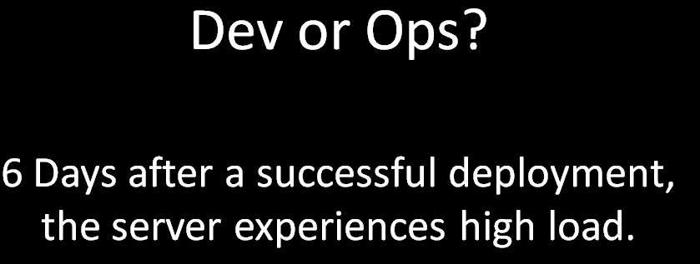

Slide 3
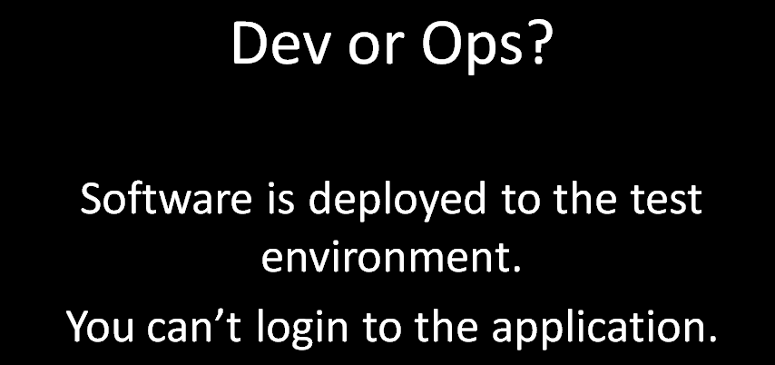

Slide 4
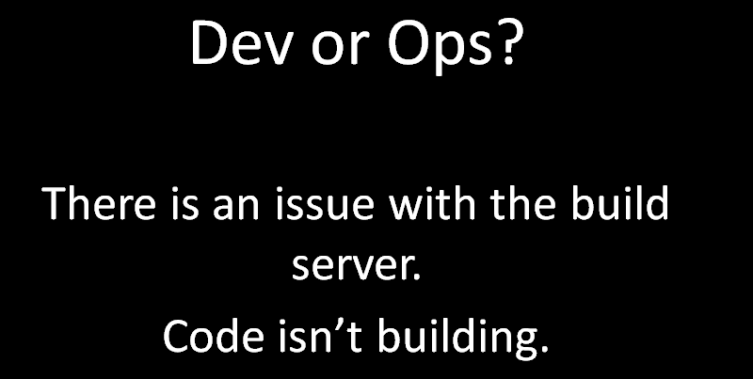

Slide 5
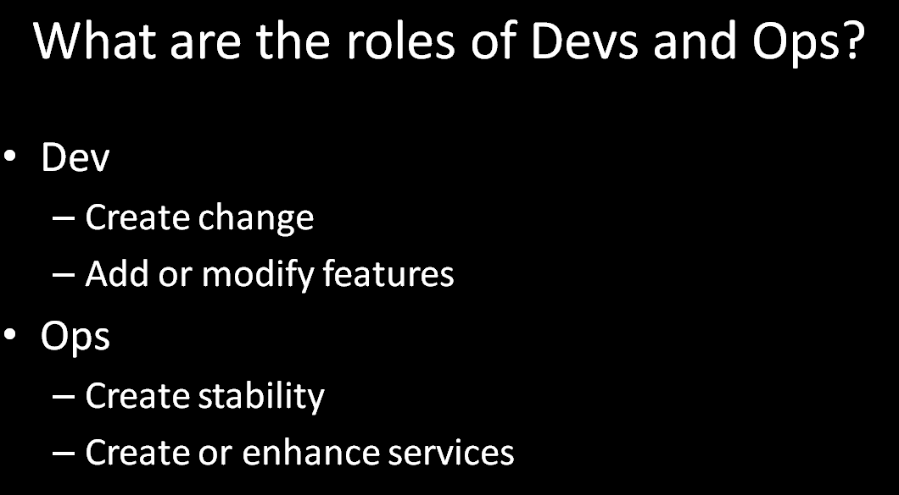
Ansible – Contents
About
Why ???
Architecture
Prerequisite
Release Structure
Execution Steps
Demo
Q & A
Notes:
TITLE PAGE
– Headline 36pt Arial in WHITE
– Sub-head 18pt Arial Reg in GREY
– Do not include client logos on title page
– TEXT ONLY
***It’s not recommended to use any sort of graphic animation. Although in some cases it may be appropriate to apply “Appear” effect to slide sections to show sections one-by-one on the slide***

Slide 6
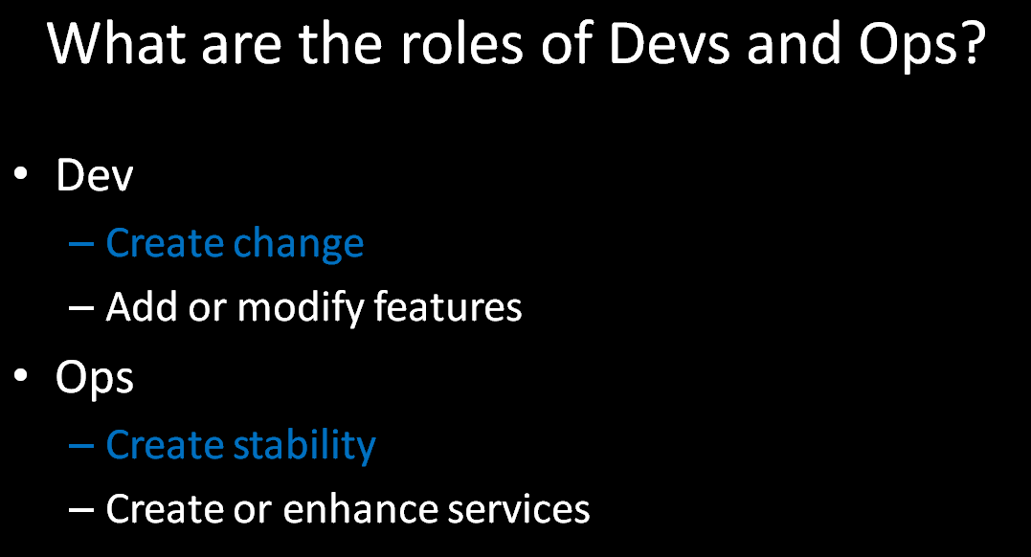

Slide 7
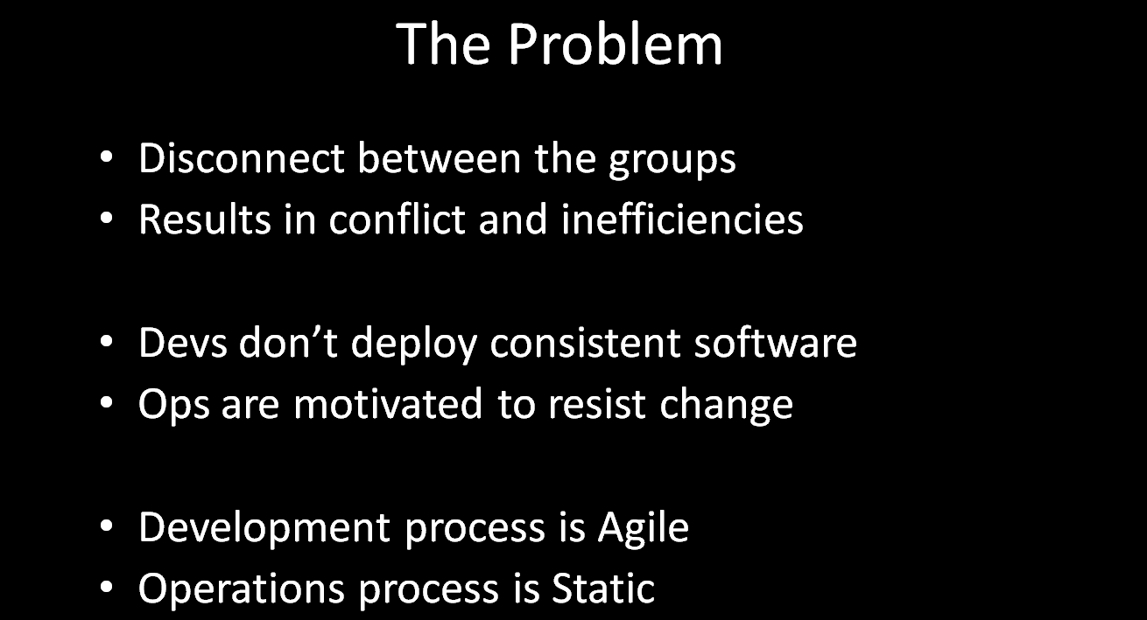
Notes:
TITLE PAGE
– Headline 36pt Arial in WHITE
– Sub-head 18pt Arial Reg in GREY
– Do not include client logos on title page
– TEXT ONLY
***It’s not recommended to use any sort of graphic animation. Although in some cases it may be appropriate to apply “Appear” effect to slide sections to show sections one-by-one on the slide***

Slide 9
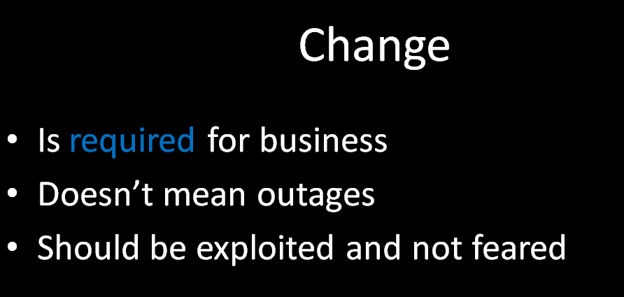

Slide 10
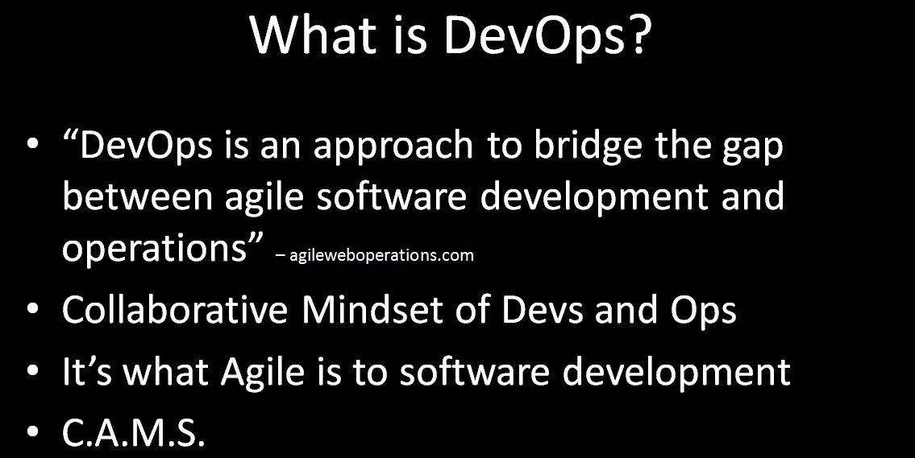

Slide 11


Slide 12
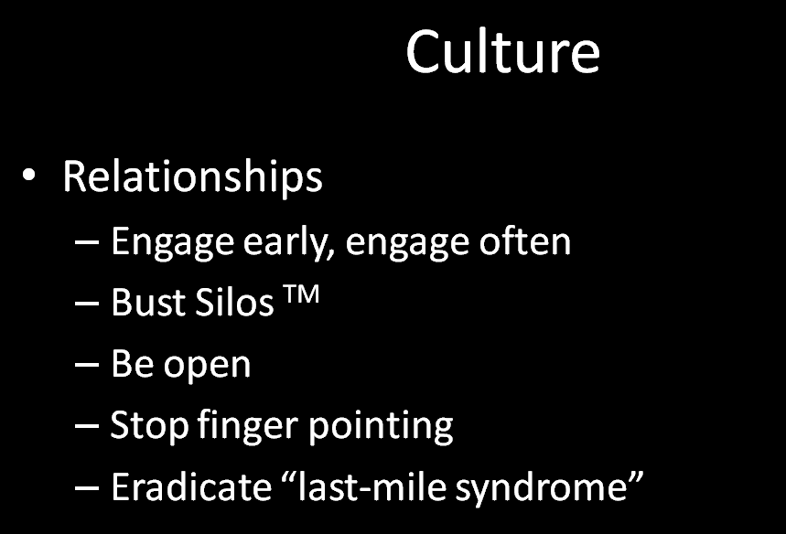

Slide 13
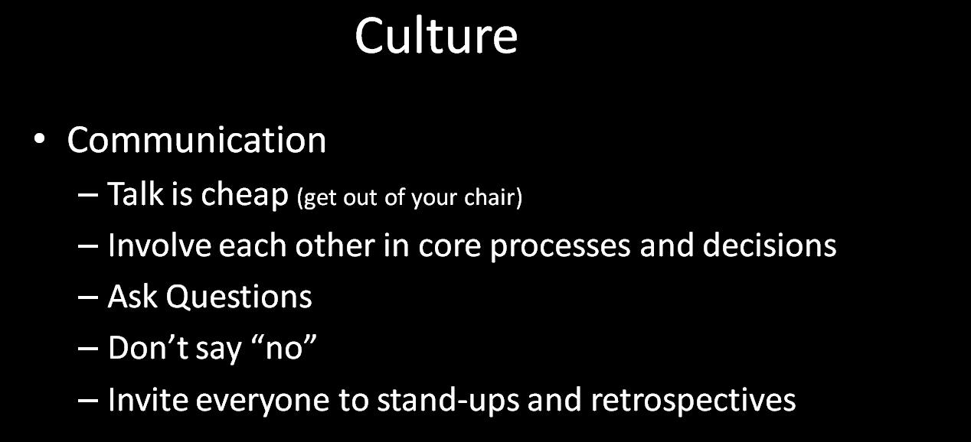

Slide 14


Slide 15
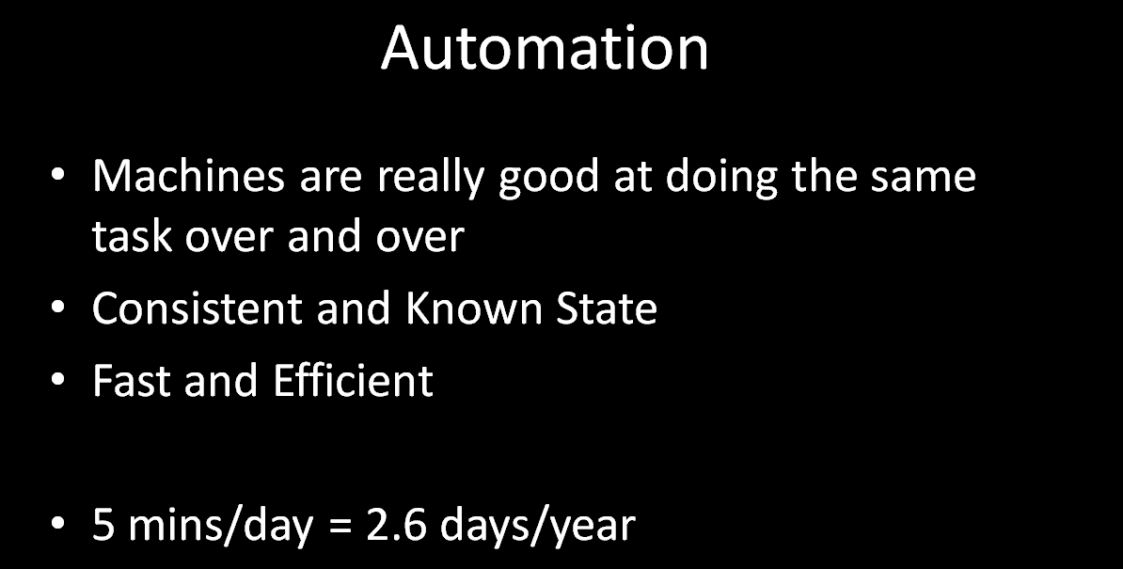

Slide 16
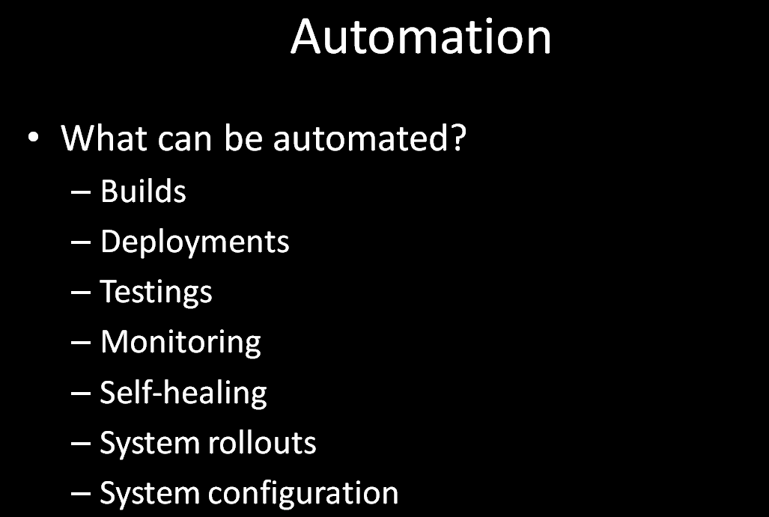

Slide 17
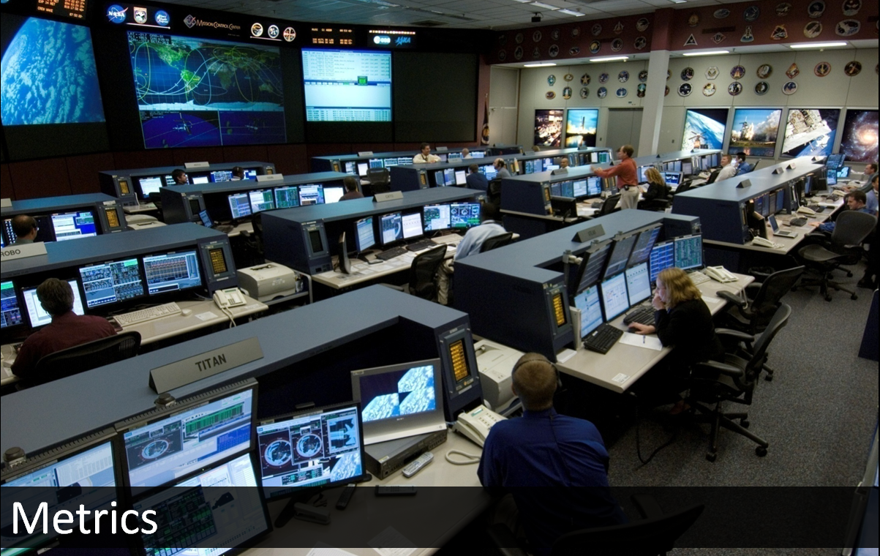

Slide 18
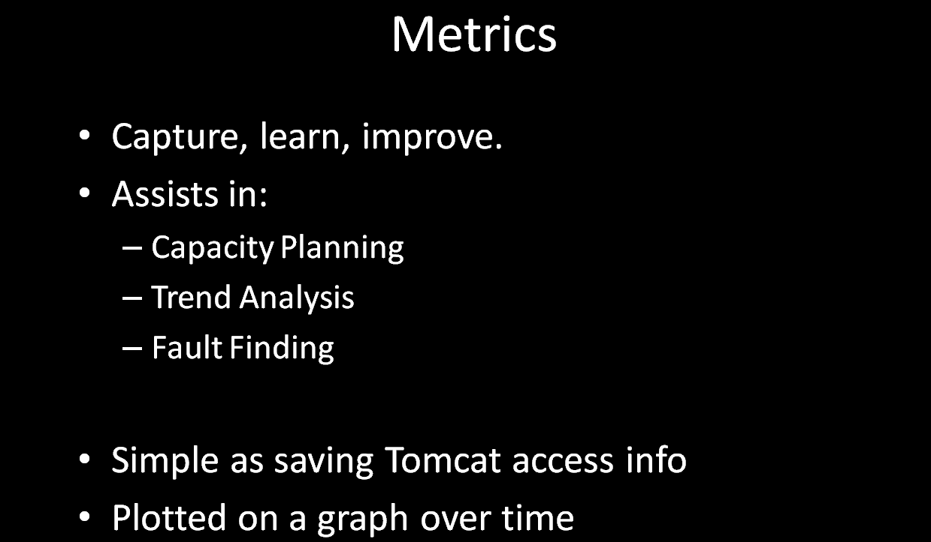



Slide 19


Slide 20
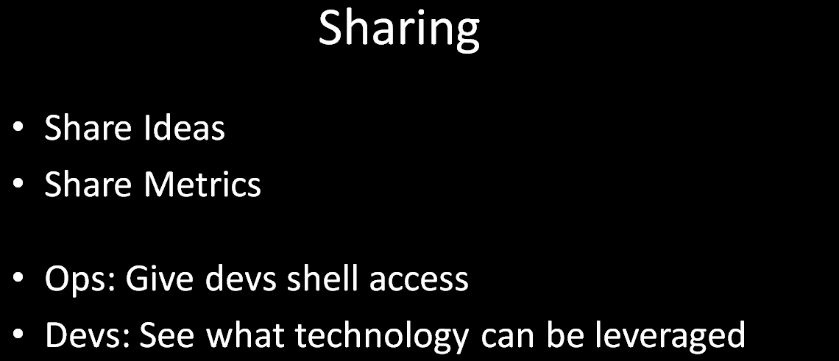

Slide 21


Slide 22
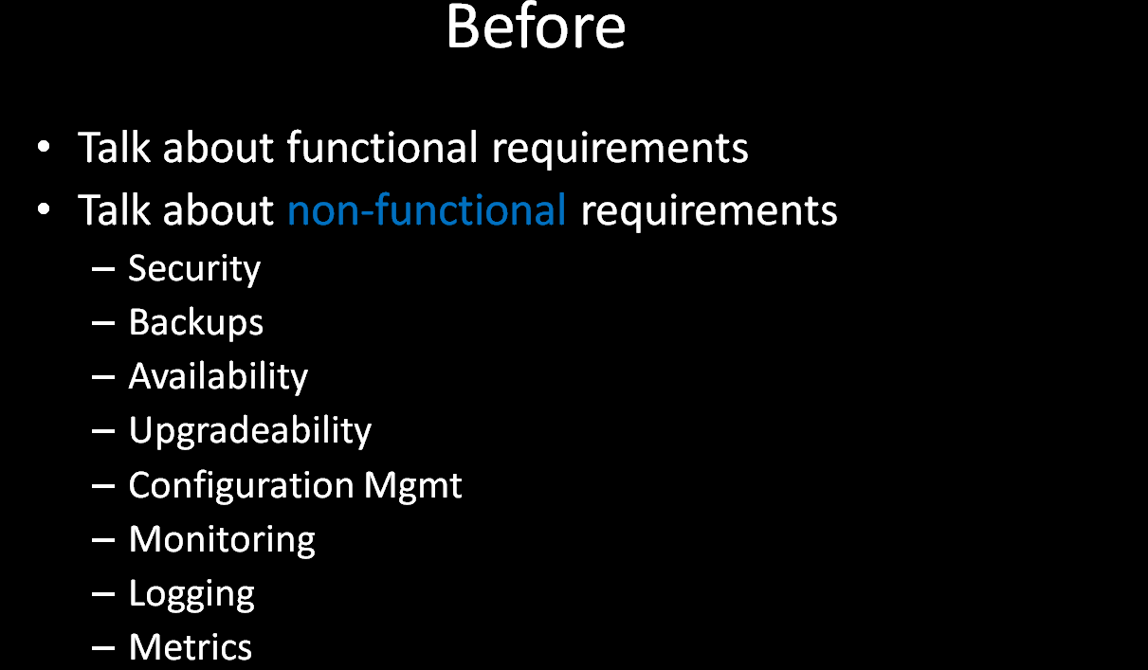



Slide 23
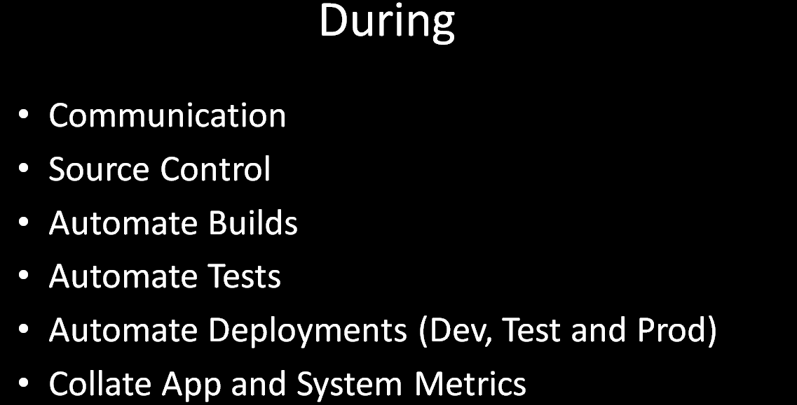

Slide 24
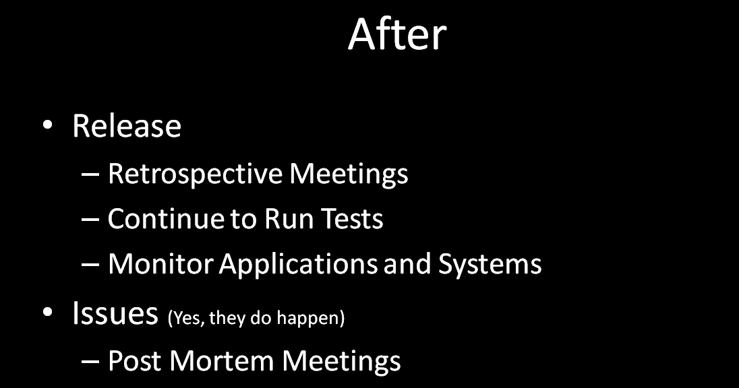



Slide 25
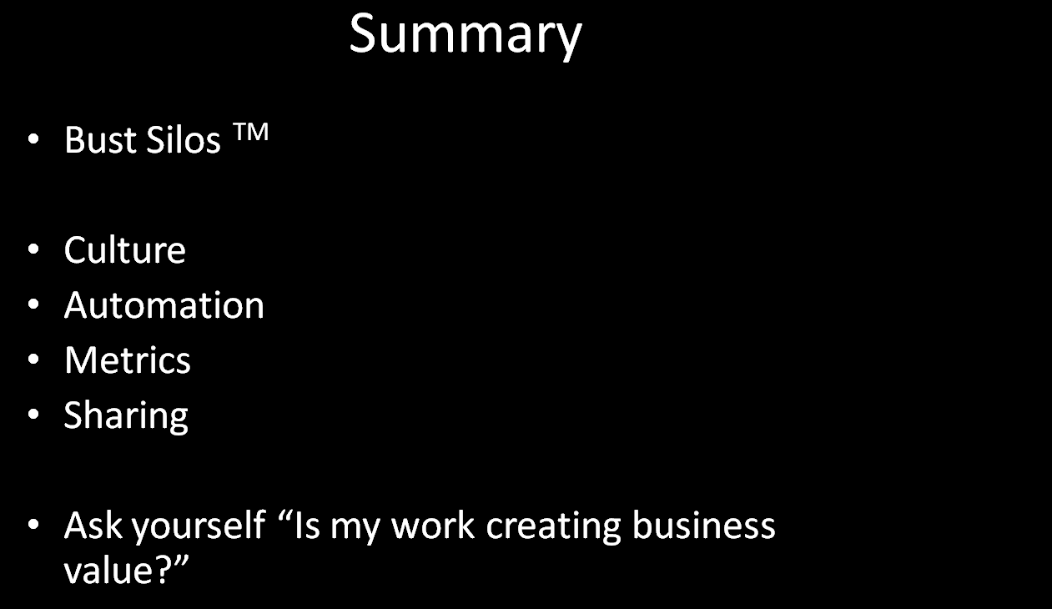



Slide 26
Thank you !

